Slide 1
Deep Dive: SQL Server on Azure Virtual Machine Storage
Pam Lahoud
Notes:
SQL Server on Azure Virtual Machines Reimagined: Storage Deep Dive
Optimizing Virtual Machine storage is one of the most critical areas to master when considering a migration to Azure SQL Virtual Machine. Azure virtual machines have input/output operations per second (IOPS) and throughput performance limits based on the virtual machine type and size. Additionally, OS disks and data disks will have their own IOPS and throughput limits. Workloads can be limited at either the virtual machine or the disk level.
In this session we demystify storage and how VM sizing will impact performance limits. We will cover what you should consider when choosing Azure disks and storage pool configurations. We will discuss Storage Spaces and Storage Pools. Finally, we will review how to monitor IOPs and throughput limits of your virtual machine, the underlying disks, and the caching capabilities of the ephemeral disks and the storage cache.
Get ready, this is one of the most important sessions to get the best performance out of your Azure virtual machine deployment!
References:
Recommended Articles:
Pricing - Managed Disks | Microsoft Azure - https://azure.microsoft.com/en-us/pricing/details/managed-disks/
Select a disk type for Azure IaaS VMs - managed disks - Azure Virtual Machines | Microsoft Docs - https://docs.microsoft.com/en-us/azure/virtual-machines/disks-types
Managed disk bursting - Azure Virtual Machines | Microsoft Docs - https://docs.microsoft.com/en-us/azure/virtual-machines/disk-bursting
Azure premium storage: design for high performance - https://docs.microsoft.com/en-us/azure/virtual-machines/premium-storage-performance
Disk metrics - Azure Virtual Machines | Microsoft Docs - https://docs.microsoft.com/en-us/azure/virtual-machines/disks-metrics
Configure storage for SQL Server VMs - https://docs.microsoft.com/en-us/azure/azure-sql/virtual-machines/windows/storage-configuration
Checklists and Best Practices:
Checklist: Performance best practices for SQL Server on Azure VMs https://aka.ms/SQLVMChecklist
VM size: Performance best practices for SQL Server on Azure VMs https://aka.ms/SQLVMSizing
Storage: Performance best practices for SQL Server on Azure VMs https://aka.ms/SQLVMStorage
How to get the biggest bang for your buck with SQL Server on Azure VMs https://aka.ms/AzureSQLVMPricePerf
Deep Dive: Azure SQL Virtual Machine Sizing | Data Exposed Live (YouTube) https://aka.ms/SQLVMSizingVideo
Reference:
Overview of SQL Server on Azure Windows Virtual Machines - SQL Server on Azure VM | Microsoft Docs
https://docs.microsoft.com/en-us/azure/azure-sql/virtual-machines/windows/sql-server-on-azure-vm-iaas-what-is-overview

Slide 2


@SQLGoddess

Slide 3

Notes:
When customers consider moving to the cloud.. What do they do typically do? From our experience, many times we are sizing SQL Server workloads by memory and CPU. It makes sense to size by cores as we are sizing based on what we have licensed, maybe we are looking at Azure Hybrid Benefits and are taking the best advantage of this benefit, and of course we know SQL Server benefits from memory as SQL Server takes advantage of what’s cached in the buffer pool and many components on the SQLOS takes advantage of memory.
- but we often miss the opportunity to size based on throughput and IOPs and this is commonly where customers are needing the performance.
The reason for this is not fully understanding the difference of CAPEX and OPEX and how it should change the way we approach architecting solutions in the cloud and how we should test and interpret the results of those tests.
To put it simply, in the cloud we only want to use what we need.
In order to accomplish this, we need to have a strong user experience - we have to carefully size and we must always be tuning (ABT) our workloads.

Slide 4
Azure Virtual Machine Disk Options

Slide 5
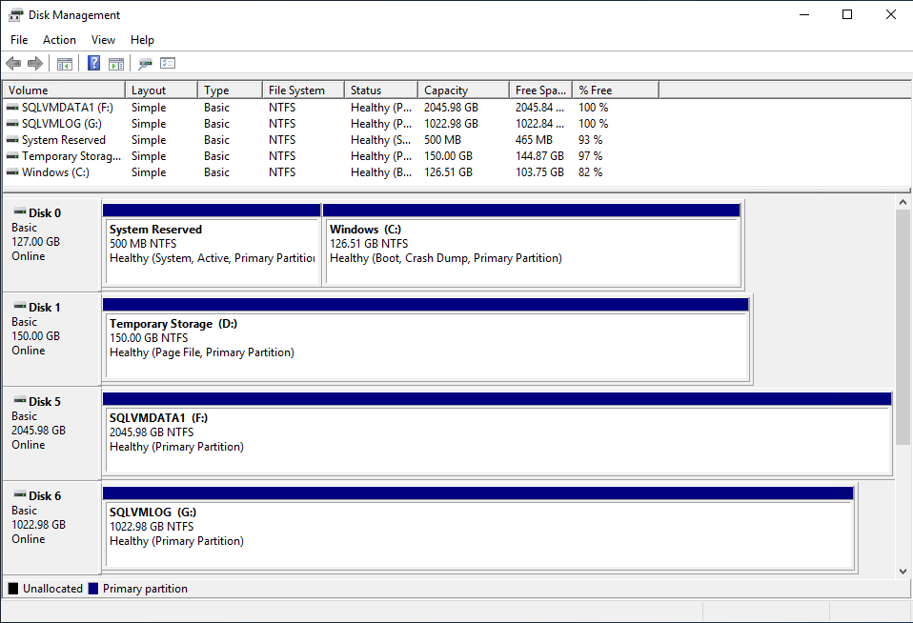
Disk roles in Azure Virtual Machines
OS Disk
C: drive
Remote (Persistent)
Temporary Disk
D: drive
Local (Ephemeral)
Data Disks
User defined drive letter
Remote (Persisted)
Notes:
Virtual machines in Azure can have three different types of disk attached to them:
An OS drive. This is created by default and will be present on every VM. It will have the OS pre-installed based on the image type chosen during VM creation.
A temporary disk. Most VM sizes will have a local temporary disk that will appear as the D: drive in the VM. This is ephemeral storage that is hosted on the SSD attached to the VM host. If the VM is powered down or migrates to a new host, the data stored here is not guaranteed to be persisted.
Data disk(s). You can attach one or more managed disks to be used as data disks by your application. This will appear as LUNs in the VM and you can assign the drive letter of your choice. This is hosted remotely by Azure Storage and uses a prioritized network channel to achieve the expected performance. The number of disks that can be attached to a VM depends on the size of the VM.
https://docs.microsoft.com/azure/virtual-machines/managed-disks-overview

Slide 6




Azure Virtual Machine Disk Provisioning
D:/
Uncached Managed Disk
Cached Managed Disk
Local / Temp
Disk
Disk-Level Provisioning
Disk-Level Provisioning
SSD-Level Provisioning
Cache Miss
Cache Hit
VM Network-Level Provisioning
Server SSD
Azure Storage Page BLOBs
Notes:
Disk allocation and performance
Here we are showing the distribution of bandwidth and IOPS for disks, using a three-level provisioning system:
1. The first level provisioning sets the per-disk IOPS and bandwidth from the VM.
2. At the second level, compute server host implements SSD provisioning, applying it only to data that is stored on the server’s local SSD, which includes disks with caching (ReadWrite and ReadOnly) as well as local and temp disks.
3. Finally, VM network provisioning takes place at the third level for any I/O that the compute host sends to Azure Storage's backend. Here, the performance of a VM depends on a several factors from how the VM uses the local SSD, to the number of disks attached, as well as the performance and caching type of the disks attached.
https://docs.microsoft.com/azure/virtual-machines/managed-disks-overview

Slide 7
Azure Managed Disk Options
Standard HDD
Standard SSD
Premium SSD
Ultra Disk
Single disk max value
Low-cost storage
Consistent performance
High performance
Sub-millisecond latency
Size
32 TiB
32 TiB
32 TiB
64 TiB
IOPS
2,000 IOPS
6,000 IOPS
20,000 IOPS
160,000 IOPS
Bandwidth
500 MBps
750 MBps
900 MBps
2,000 MBps
Disk Labels
E1 – E80
S4 – S80
P1 – P80
*Configurable
http://aka.ms/azuredisks
Notes:
What disk types are available in Azure?
There are currently four basic disk options.
Standard HDD - Backup, non-critical, infrequent access; Standard SSDs have the S# naming convention
Standard SSD - Web servers, lightly used departmental apps and dev/test; Standard SSDs have the E# naming convention
Premium SSD - Production and performance sensitive workloads ; Premium disks have the P# naming convention
Ultra disk SSD - IO-intensive workloads such as SAP HANA, top tier databases (for example, SQL, Oracle), and other transaction-heavy workloads. These are independently configurable.
Like standard HDDs, standard SSDs are available on all Azure VMs, but..
Recommendations
We do not recommend using Standard HDDs and Standard SSDs for SQL Server workloads – which is why I am going to turn off half the screen.
Standard disk options should only be used for non-production scenarios and maybe for web servers and lightweight application servers.
Not only is the IOPs and throughput lower than Premium and Ultra Disks, but it is also not guaranteed.
For Standard Disks, the actual IOPS and throughput may vary depending on the traffic patterns.
The IOPS and throughput limits are available 99% of the time.
Therefore, we only recommend Premium SSD and Ultra Disk options for production workloads.
Azure disk reservation
Just a real quick comment on pricing, disk reservation is another reason to consider premium disks. Disk reservations lets you prepurchase 1 year of disk storage in advance at a discount. When purchasing a disk reservation, you select a specific disk SKU in a target region for a one-year term. The reservation experience is similar to reserving virtual machine (VM) instances. You can even bundle VM and Disk reservations – so it can be a pretty effective way to maximize TCO.
For more details on the Reserved Disks pricing, see Azure Disks pricing page - http://aka.ms/azuredisks
Reference
About disks and VHDs for Azure virtual machines https://azure.microsoft.com/en-us/documentation/articles/virtual-machines-windows-about-disks-vhds/
Premium Storage: High-Performance Storage for Azure Virtual Machine Workloads
https://azure.microsoft.com/en-us/documentation/articles/storage-premium-storage/#ds-dsv2-and-gs-series-vms
Azure premium storage: design for high performance
https://docs.microsoft.com/en-us/azure/virtual-machines/premium-storage-performance

Slide 8
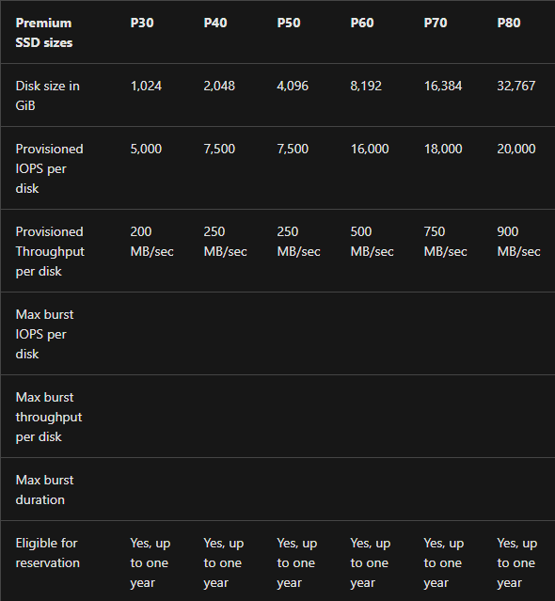
Premium SSD
Production and performance sensitive workloads
Disk-level provisioning
Notes:
Premium SSD
Premium SSDs have low-latency disk support perfect for IO-intensive mission-critical workloads. Premium SSDs can only be used with VM series that support premium storage and we only recommend VMs that support both Premium Disk storage and caching.
An Azure VM supports attaching several Premium Storage disks in a storage pool, so applications can have up to 64 TB of storage per VM. This is what Storage Spaces is doing for us behind the scenes – which we will get to in a little more detail, but just think of it as a software RAID solution for the purposes of combining disks for performance and capacity.
Virtual Machines can achieve up to 80,000 uncached IOPS (input/output operations per second) per VM and 2 GB uncached per second disk throughput using storage spaces.
Premium disks helps support this solution with disks scaled from the P1 up to the P80, but there are features only available on certain disk sizes. Bursting is available on the P1 to P20, caching is available on the P30 and P40s. Reservations are available for disks P30 and larger for example.
Recommendation:
Because of the caching support we only recommend using P30 and P40 for the Data disks. Caching support is not recommended for log files so admins can use P30 – P80 for the Log disks.
We recommend customers start with the P30 and use storage spaces to increase the throughput to the VMs limits.
It is not recommended to use disks that support disk level bursting (P1 – P20) as the experience can be inconsistent and lead to perceptions of poor performance.
The reason is that bursting is automatic and operates based on a credit system and under this credit system.
All burst disk sizes start with a full burst when the disk is attached to a Virtual Machine. Bursting supports a max duration at the peak burst limit of 30 mins.
I personally only recommend intentionally using bursting for web servers and application servers.
------------------------
Advice
Taking a look at the premium disk options, start considering disks at the P30 and P40 levels.
Most customers choose P30 or P40s for their SQL Server data files in a large stripe, storage pool and will have a separate pool for their log drive.
Separate data and log is very important, not just for workload separation, but for caching reasons which we will discuss later.
Remember, the disk IOps and throughput should not exceed what that virtual machine can handle.
What disk types are available in Azure? https://docs.microsoft.com/en-us/azure/virtual-machines/disks-types#premium-ssd

Slide 9
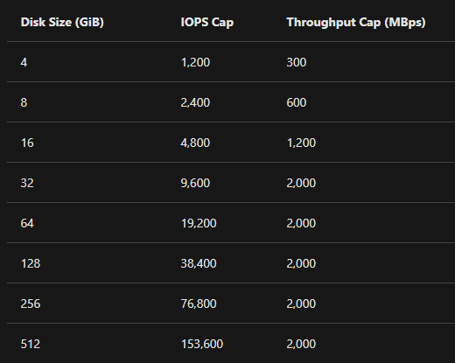

Ultra Disk
IO-intensive workloads such as top databases and other transaction-heavy workloads
1,024-65,536 – sizes in this range increases in increments of 1 TiB
Notes:
Ultra-disk
Ultra-disks have high throughput, high IOPS, and very low latency. Basically, you are paying for the latency. They are perfect for data-intensive workloads such high-end databases and transaction-heavy workloads. In particular, they are useful for the transaction log when you have high log usage from SQL Server features (such as replication + Always On AGs) and / or you have high WRITELOG waits.
Basically, use Ultra Disks for when you need very low latency writes (<1ms) to the log files
Ultra Disk is configurable - when you provision an ultra-disk, you can independently configure the capacity and performance of the disk separately - in several fixed sizes, ranging from 4 GiB up to 64 TiB.
Key Points:
Ultra-disks can dynamically adjust disk performance without the need to restart your virtual machines (VM).
There is no caching support – Ultra disks only supports un-cached reads and un-cached writes.
Ultra-disk performance:
Disk capacity: Ultra disks capacity ranges from 4 GiB up to 64 TiB.
Disk IOPS: Ultra disks support IOPS limits of 300 IOPS/GiB, up to a maximum of 160K IOPS per disk.
To achieve the IOPS that you provisioned, ensure that the selected Disk IOPS are less than the VM IOPS limit (avoid VM throttling / capping).
Disk throughput: With ultra-disks, the throughput limit is up to a maximum of 2 GBs (2000 MBps) per disk.
Ultra-disks supports adjusting the disk performance attributes (IOPS and throughput) at runtime without detaching the disk from the virtual machine.
Ultra-disks limitations:
The only infrastructure redundancy options currently supported are availability zones.
Not every VM size is available in every supported region with ultra-disks.
Does not support disk caching
Doesn't currently support disk snapshots, VM images, availability sets, Azure Dedicated Hosts, or Azure disk encryption.
Doesn't currently support integration with Azure Backup or Azure Site Recovery.
------------------------------------------
Once a disk performance resize operation has been issued on a disk, it can take up to an hour for the change to actually take effect.
There is a limit of four performance resize operations during a 24-hour window.
It is possible for a performance resize operation to fail due to a lack of performance bandwidth capacity.
References: What disk types are available in Azure? https://docs.microsoft.com/en-us/azure/virtual-machines/disks-types#ultra-disk
Using Azure ultra disks
https://docs.microsoft.com/en-us/azure/virtual-machines/disks-enable-ultra-ssd?tabs=azure-portal

Slide 10
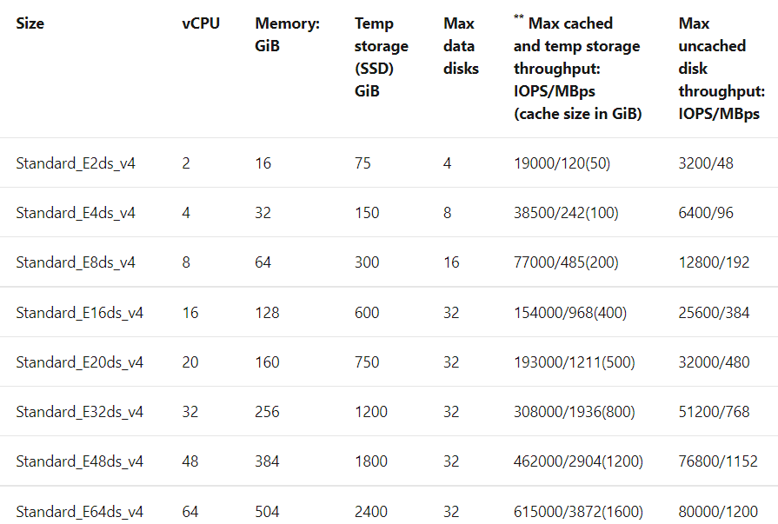
VM I/O Limits
https://docs.microsoft.com/azure/virtual-machines/edv4-edsv4-series
Notes:
** These IOPs values can be guaranteed by using Gen2 VMs

Slide 11
VM I/O Limits
VM network-level provisioning
Notes:
Max uncached disk throughput is the VM-level limit for remote storage.

Slide 12
VM I/O Limits
Size of D: drive
SSD-level provisioning
Notes:
Max cached and temp storage throughput is the VM limit for local SSD storage. This includes I/O against the local ephemeral drive (D: drive) and the cache.

Slide 13
Understanding I/O Capping

Slide 14


Disk-level I/O Capping
SQL Server
Size | Standard_E8ds_v4
Uncached disk throughput: IOPS/MBps | 12800/192
1,500 IOPs
Request
10,000 IOPs
Request
500 IOPs
Request
Standard_E8ds_v4
500 IOPs
Request
1,000 IOPs
Request
4,500 IOPs
Request
500 IOPs
Request
Size | P10
IOPS/MBps | Up to 500/100
4,500 IOPs
Request
Data Disk P10
Data Disk P10
Data Disk P10
Notes:
How does disk performance work?
This is a bit of a recap –remember that Azure virtual machines have IOPS and throughput performance limits based on the virtual machine type and size and all disks will have their own IOPS and throughput limits.
Performance can get capped when the application requests more IOPS (or throughput) than what is allotted for the virtual machines or attached disks.
When capped, applications may experience suboptimal performance through increased latency.
Consider this example… (Disk Throttling..) We have an E8ds_v4. This virtual machine has 8 vCore, 64 GBs of memory. The key piece is that there are 12,800 uncached IOPS for this machine.
In this case we have configured 3 x Premium P10 disks.
There are 3 x P10 data disks that each support up to 500 IOPS and up to 60 MB/second throughput, assume that SQL Server data/log/tempdb files are hosted across them.
Here is the process..
The application makes a request that requires 10,000 IOPS to the virtual machine. This is fine because the Standard_E8ds_v4 virtual machine can handle up to 12,800 IOPS.
The 10,000 IOPS are then broken down into three different requests to the different disks:
1,000 IOPS are requested to the first data disk.
4,500 IOPS are requested to each of the remaining two data disks.
Here’s where we run into a problem.
All attached disks are P10 disks and they can only handle 500 IOPS.
So, the disks respond back with 500 IOPS each. The application's performance is capped by the attached disks, and it can only process 1,500 IOPS to the application.
The application could obtain peak performance at 10,000 IOPS if better-performing disks were used, such as Premium SSD P30 disks.

Slide 15
Disk-level I/O Capping
SQL Server
Size | Standard_E8ds_v4
Uncached disk throughput: IOPS/MBps | 12800/192
10,000 IOPs
Request
10,000 IOPs
Request
1,000 IOPs
Request
Standard_E8ds_v4
4,500 IOPs
Request
1,000 IOPs
Request
4,500 IOPs
Request
4,500 IOPs
Request
Size | P30
IOPS/MBps | Up to 5000/200
4,500 IOPs
Request
Data Disk P30
Data Disk P30
Data Disk P30
Notes:
Okay, now we have upgraded our disks from the Premium SSD P10s to the Premium SSD P30s.
We have improved from 500 IOPS / 60 MBPs, to 5,000 IOPS / 200 MBPs and now the application's performance is not limited.
The application is getting the full 10,000 IOPs it is asking for only because better performing disks were used, such as these Premium SSD P30 disks.
This is good. No throttling is occurring at this disk level.

Slide 16
VM-level I/O Capping
SQL Server
Size | Standard_E8ds_v4
Uncached disk throughput: IOPS/MBps | 12800/192
12,800 IOPs
Request
15,000 IOPs
Request
5,000 IOPs
Request
Standard_E8ds_v4
5,000 IOPs
Request
5,000 IOPs
Request
5,000 IOPs
Request
5,000 IOPs
Request
Size | P30
IOPS/MBps | Up to 5000/200
5,000 IOPs
Request
Data Disk P30
Data Disk P30
Data Disk P30
Notes:
So now… Consider this example… this time at the virtual machine level (VM IO Throttling..)
In this case we are increasing the applications required IOPS. The app is now asking for 15,000 IOPS.
Again… We have a Standard_E8ds_v4. The key piece here is that there are 12,800 uncached IOPS for this machine. We also have the P30 Disks.
There are 3 x P30 data disks that each support up to 5,000 IOPS.
Here is the process..
The application running on the virtual machine makes a request that requires 15,000 IOPS to the VM.
The 15,000 IOPS are then broken down into three different requests to the different disks with 5,000 IOPS are requested to each data disk.
All attached disks are P30 disks and they can handle 5,000 IOPS. So, they respond back with their requested amounts.
Because the E8ds_v4 virtual machine can execute only up to uncached 12,800 IOPS, this limits what is returned to the application.
In this case the virtual machine is capping the IOPS and not the underlying disks.
It may not be by a lot, but the application is not getting all the IOPS it is asking for.

Slide 17
Understanding Host Caching

Slide 18
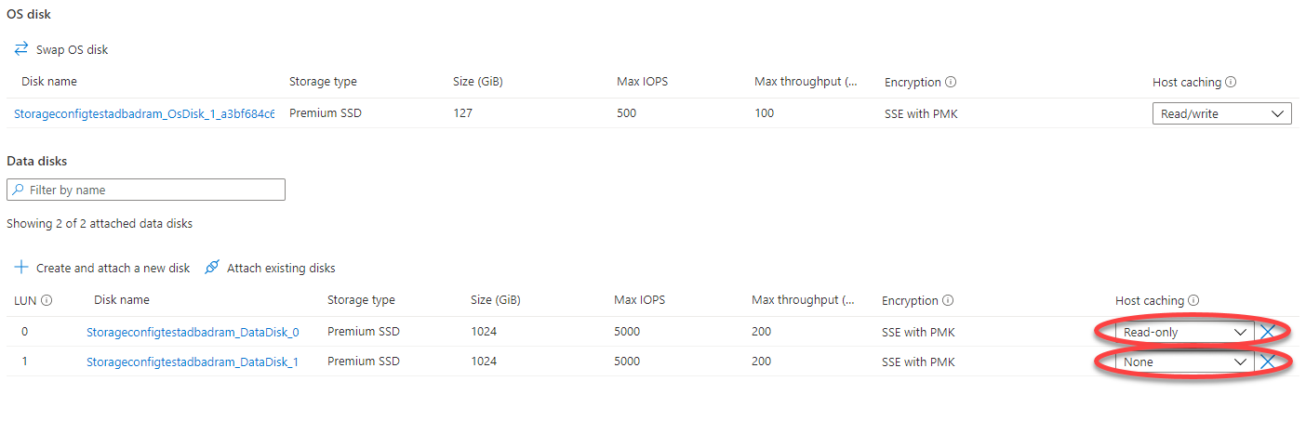
Enabling VM Host Caching
Notes:
Enabling Host VM Caching
You can adjust the host caching to match your workload requirements for each disk. You can set your host caching to be:
None: No caching would be used. This is the default when you add a new data disk.
Read-only: For workloads that do read only operations. This would be your data disks and TempDB if you can’t fit it on the ephemeral D:\ drive.
Read/write: For workloads that do a balance of read and write operations. This is the default for the OS Disk. We do not recommend changing the operating system caching policy.
We do recommend that you use Read-only for data files and any remote tempdb configuration.
We recommend that you use no caching at all for the log file. The log file would not benefit from read caching and you are losing the cache where it could be more useful for other storage needs.
So, you should only be choosing ‘read-only’ caching or ‘none’.

Slide 19


How ReadOnly Caching Works (Reads)
If the data is NOT available in cache…
Read Request
Read Request
Read Response
Read Response
VM Size
Cache
Uncached Disk
Reads are counted toward the VM cached limit and the uncached limit
Notes:
How ReadOnly Caching Works (Reads) –
Let's run through a couple examples of different host cache settings to see how it affects the data flow and performance. In this first example, we'll look at what happens with IO requests when the host caching setting is set to Read-only, but the data is NOT available in cache…
When a read is performed and the desired data is not available on the cache, the read request is sent to the disk.
Then the disk surfaces it to both the cache and the VM.
So, this read is counted toward both the VM's uncached limit and the VM's cached limit.

Slide 20
How ReadOnly Caching Works (Reads)
If the data is available in cache…
Read Request
Read Response
VM Size
Cache
Uncached Disk
Reads are counted toward the VM cached limit, but not the uncached limit
Notes:
How Host Caching Works - If the data is available in cache…
When a read is performed and the desired data is available on the cache, the cache returns the requested data. There is no need to read from the disk. !!!This read is ONLY counted toward the VM's cached limits.

Slide 21
How ReadOnly Caching Works (Writes)
Completing a write operation…
Write Operation
Write Operation
VM Size
Cache
Uncached Disk
Writes are counted toward the VM uncached limit and the cached limit
Notes:
When a write is performed, the write has to be written to both the cache and the disk before it is considered complete.
This write is counted toward the VM's uncached limit and the VM's cached limit.

Slide 22
How ReadWrite Caching Works (Writes) The only difference is when a write occurs..
Lazy Write Operation
Write Operation
VM Size
Cache
Uncached Disk
Writes are counted toward the VM cached limit and the uncached limit
Notes:
Now let's look at what happens with IO requests when the host cache setting is set to Read/write.
The reads are simple. A read is handled the same way as a read-only. The writes are the only thing that's different with read/write caching.
When writing with host caching set to Read/write, the write needs to be written to the host cache to be considered complete.
The write is then lazily written to the disk during a background process. This means that a write is counted towards cached IO when it is written to the cache. When it is lazily written to the disk, it counts toward the uncached IO.
This is why you don’t want to enable write caching for the transaction log. You are basically chewing up the cache for writes and never getting any benefit from read operations.

Slide 23

Benefits of Host Caching
SQL Server
15,000 IOPs
Request
15,000 IOPs
Request
Size | Standard_E8ds_v4
Uncached disk throughput: IOPS/MBps | 12800/192
Cached disk throughput: IOPS/MBps (cache size in GiB) | 77000/485 (200)
Standard_E8ds_v4
15,000 IOPs
Request
15,000 IOPs
Request
Size | P30
IOPS/MBps | Up to 5000/200
5,000 IOPs
Request
5,000 IOPs
Request
5,000 IOPs
Request
Host Cache
5,000 IOPs
Request
5,000 IOPs
Request
5,000 IOPs
Request
No VM or Disk Capping!
Data Disk P30 (RO)
Data Disk P30 (RO)
Data Disk P30 (RO)
Notes:
Benefits of Host Caching
We are going back to the previous example, but we are going to fix it with caching.
Again, We are using a E8ds_v4 (12800 IOPS uncached; 77000 IOPS cached ) virtual machine has readonly caching enabled for the data disks.
The application is again requesting 15,000 IOPS.
The requests are broken down as 5,000 IOPS to each underlying disk attached.
Because caching is enabled for the underlying storage, we can get the 15,000 IOPS from the cached throughput, and we do not run into the uncached limits of the virtual machine. With caching enabled, even at 15000 IOPS, no performance capping occurs.

Slide 24
Choosing the Right VM Size

Slide 25
Azure Virtual Machine Disk Provisioning
D:/
Uncached P30 Managed Disk
Cached P30 Managed Disk
Local / Temp
Disk
5,000 IOPS 200 MBps
5,000 IOPS 200 MBps
77,000 IOPS, 485 MBps
Cache Miss
Cache Hit
12,800 IOPS, 192 MBps
Server SSD
Azure Storage Page BLOBs
Notes:
Disk allocation and performance
Let’s see how this applies to the virtual machine we have been using in our examples.
Consider the Standard_E8ds_v4. The Standard_E8ds_v4 would prevent achieving the 20,000 IOPS of a 4 x P30 storage pool, because of limits at the VM level.
Now, if the pool could leverage read-only caching, we could improve on this limitation with an additional 64,000 IOPS.
We are able to leverage the ephemeral disk for tempdb which won’t count against our uncached IOPS and throughput.
Spreading out and isolating these data, log and tempdb further ensures workloads can get the expected IOPS and throughput it needs.
You can use the VM-level and Disk-level metrics to track the performance and setup alerts as needed. Please see the references on Azure Disk Metrics and our previous performance monitor references.
-------------------------------------
Other Points:
Some things to be aware of is that Azure prioritizes the network channel for disk traffic over other lower priority traffic which helps improve performance and Azure Storage implements automatic load balancing.
Azure Storage allocates required resources when you create a disk and applies proactive and reactive balancing of resources to handle the traffic level.

Slide 26
Azure Virtual Machine Disk Provisioning
D:/
Uncached P30 Managed Disk
Cached P30 Managed Disk
Local / Temp
Disk
Transaction Log files
(host caching = None)
5,000 IOPS 200 MBps
5,000 IOPS 200 MBps
77,000 IOPS, 485 MBps
Cache Miss
Cache Hit
12,800 IOPS, 192 MBps
Server SSD
Azure Storage Page BLOBs
Notes:
Disk allocation and performance
Let’s see how this applies to the virtual machine we have been using in our examples.
Consider the Standard_E8ds_v4. The Standard_E8ds_v4 would prevent achieving the 20,000 IOPS of a 4 x P30 storage pool, because of limits at the VM level.
Now, if the pool could leverage read-only caching, we could improve on this limitation with an additional 64,000 IOPS.
We are able to leverage the ephemeral disk for tempdb which won’t count against our uncached IOPS and throughput.
Spreading out and isolating these data, log and tempdb further ensures workloads can get the expected IOPS and throughput it needs.
You can use the VM-level and Disk-level metrics to track the performance and setup alerts as needed. Please see the references on Azure Disk Metrics and our previous performance monitor references.
-------------------------------------
Other Points:
Some things to be aware of is that Azure prioritizes the network channel for disk traffic over other lower priority traffic which helps improve performance and Azure Storage implements automatic load balancing.
Azure Storage allocates required resources when you create a disk and applies proactive and reactive balancing of resources to handle the traffic level.

Slide 27
Azure Virtual Machine Disk Provisioning
D:/
Uncached P30 Managed Disk
Cached P30 Managed Disk
Local / Temp
Disk
Data files
(host caching = Read-only)
5,000 IOPS 200 MBps
5,000 IOPS 200 MBps
77,000 IOPS, 485 MBps
Cache Miss
Cache Hit
12,800 IOPS, 192 MBps
Server SSD
Azure Storage Page BLOBs
Notes:
Disk allocation and performance
Let’s see how this applies to the virtual machine we have been using in our examples.
Consider the Standard_E8ds_v4. The Standard_E8ds_v4 would prevent achieving the 20,000 IOPS of a 4 x P30 storage pool, because of limits at the VM level.
Now, if the pool could leverage read-only caching, we could improve on this limitation with an additional 64,000 IOPS.
We are able to leverage the ephemeral disk for tempdb which won’t count against our uncached IOPS and throughput.
Spreading out and isolating these data, log and tempdb further ensures workloads can get the expected IOPS and throughput it needs.
You can use the VM-level and Disk-level metrics to track the performance and setup alerts as needed. Please see the references on Azure Disk Metrics and our previous performance monitor references.
-------------------------------------
Other Points:
Some things to be aware of is that Azure prioritizes the network channel for disk traffic over other lower priority traffic which helps improve performance and Azure Storage implements automatic load balancing.
Azure Storage allocates required resources when you create a disk and applies proactive and reactive balancing of resources to handle the traffic level.

Slide 28
Azure Virtual Machine Disk Provisioning
D:/
Uncached P30 Managed Disk
Cached P30 Managed Disk
Local / Temp
Disk
tempdb files
(local drive, no caching)
5,000 IOPS 200 MBps
5,000 IOPS 200 MBps
77,000 IOPS, 485 MBps
Cache Miss
Cache Hit
12,800 IOPS, 192 MBps
Server SSD
Azure Storage Page BLOBs
Notes:
Disk allocation and performance
Let’s see how this applies to the virtual machine we have been using in our examples.
Consider the Standard_E8ds_v4. The Standard_E8ds_v4 would prevent achieving the 20,000 IOPS of a 4 x P30 storage pool, because of limits at the VM level.
Now, if the pool could leverage read-only caching, we could improve on this limitation with an additional 64,000 IOPS.
We are able to leverage the ephemeral disk for tempdb which won’t count against our uncached IOPS and throughput.
Spreading out and isolating these data, log and tempdb further ensures workloads can get the expected IOPS and throughput it needs.
You can use the VM-level and Disk-level metrics to track the performance and setup alerts as needed. Please see the references on Azure Disk Metrics and our previous performance monitor references.
-------------------------------------
Other Points:
Some things to be aware of is that Azure prioritizes the network channel for disk traffic over other lower priority traffic which helps improve performance and Azure Storage implements automatic load balancing.
Azure Storage allocates required resources when you create a disk and applies proactive and reactive balancing of resources to handle the traffic level.

Slide 29
Measure Application Performance Requirements
Counter | Description | PerfMon (Windows) | Iostat (Linux)
IOPS or Transactions per second | Number of I/O requests issued to the storage disk per second. | Disk Reads/sec | tps
 |  | Disk Writes/sec | r/s
 |  |  | w/s
Throughput | Amount of data read from or written to the disk per second. | Disk Read Bytes/sec | kB_read/s
 |  | Disk Write Bytes/sec | kB_wrtn/s
Latency | Total time to complete a disk IO request. | Average Disk sec/Read | await
 |  | Average disk sec/Write | svctm
Uncached IOPS/MBps
Roughly maps to transaction log reads and writes + data file writes and ~ 70% of reads (depends on host cache hit ratio)
Cached and local IOPS/MBps
Roughly maps to tempdb reads and writes + data file reads and writes
Notes:
Counters to measure application performance requirements
The best way to measure performance requirements of your application, is to use performance-monitoring tools provided by the operating system of the server. You can use PerfMon for Windows and iostat for Linux. These tools capture counters corresponding to each measure explained in the above section. You must capture the values of these counters when your application is running its normal, peak, and off-hours workloads.
The PerfMon counters are available for processor, memory and, each logical disk and physical disk of your server. When you use premium storage disks with a VM, the physical disk counters are for each premium storage disk, and logical disk counters are for each volume created on the premium storage disks. You must capture the values for the disks that host your application workload. If there is a one to one mapping between logical and physical disks, you can refer to physical disk counters; otherwise refer to the logical disk counters.
On Linux, the iostat command generates a CPU and disk utilization report. The disk utilization report provides statistics per physical device or partition. If you have a database server with its data and logs on separate disks, collect this data for both disks.
Counters to measure application performance requirements
https://docs.microsoft.com/en-us/azure/virtual-machines/premium-storage-performance#counters-to-measure-application-performance-requirements

Slide 30
Recommended SQL VM Memory Optimized Series
Edsv4-series
M-series
Highest I/O throughput and memory available in Azure
Great for mission critical OLTP and high-end data warehouse workloads
Best all-purpose SQL Server virtual machine
Large local drives with high local/cached throughput
DSv2-series 11-15
Good entry level SQL Server virtual machine
Offers best price-performance for SQL Server workloads
Good remote throughput
Very expensive – start with Edsv4 first if possible
Notes:
Going quick here..
We recommend the Memory Optimized virtual machines, the Storage Optimized, and some select General Purpose virtual machines.- check episode 1 for more information.
We primarily recommend memory optimized virtual machine sizes as the primary target for SQL Server VMs and it’s the recommended choice for SQL Server.
The DSv2-series 11-15 has a consistent memory-to-CPU ratio of 7 across all virtual machines and premium storage and premium storage caching, which is strongly recommended for optimal performance.
The Edsv4-series, has strong storage throughput, large local storage SSD capacity, strong local disk IOPS, up to 504 GiB of RAM, improved compute compared to the previous versions and there is consistent vCore-to-memory ratio of 1:8 across these virtual machines as you scale – and of course these machines also support premium storage, and premium storage caching.
The M-series, including M, Mv2, Msv2, and Mdsv2 Medium, has higher vCore counts and memory for some of the largest SQL Server workloads. Think it terms of big workloads, larger memory to core ratio, and mission critical or data warehouse needs. The Mv2-series has the highest vCore counts and memory and is recommended for mission critical and data warehouse workloads.
This M-series supports premium storage and premium storage caching support, has ultra-disk support, and write acceleration.
There is also the new Msv2 and Mdsv2-series Medium Memory which as a mid-tiered memory profile in comparison with the other M-series options.

Slide 31
Recommended SQL VM Memory Optimized Series
Edsv4-series
M-series
Highest I/O throughput and memory available in Azure
Great for mission critical OLTP and high-end data warehouse workloads
Best all-purpose SQL Server virtual machine
Large local drives with high local/cached throughput
DSv2-series 11-15
Good entry level SQL Server virtual machine
Offers best price-performance for SQL Server workloads
Good remote throughput
Very expensive – start with Edsv4 first if possible
When in doubt, pick this one!
Notes:
Going quick here..
We recommend the Memory Optimized virtual machines, the Storage Optimized, and some select General Purpose virtual machines.- check episode 1 for more information.
We primarily recommend memory optimized virtual machine sizes as the primary target for SQL Server VMs and it’s the recommended choice for SQL Server.
The DSv2-series 11-15 has a consistent memory-to-CPU ratio of 7 across all virtual machines and premium storage and premium storage caching, which is strongly recommended for optimal performance.
The Edsv4-series, has strong storage throughput, large local storage SSD capacity, strong local disk IOPS, up to 504 GiB of RAM, improved compute compared to the previous versions and there is consistent vCore-to-memory ratio of 1:8 across these virtual machines as you scale – and of course these machines also support premium storage, and premium storage caching.
The M-series, including M, Mv2, Msv2, and Mdsv2 Medium, has higher vCore counts and memory for some of the largest SQL Server workloads. Think it terms of big workloads, larger memory to core ratio, and mission critical or data warehouse needs. The Mv2-series has the highest vCore counts and memory and is recommended for mission critical and data warehouse workloads.
This M-series supports premium storage and premium storage caching support, has ultra-disk support, and write acceleration.
There is also the new Msv2 and Mdsv2-series Medium Memory which as a mid-tiered memory profile in comparison with the other M-series options.

Slide 32
Storage Best Practices

Slide 33
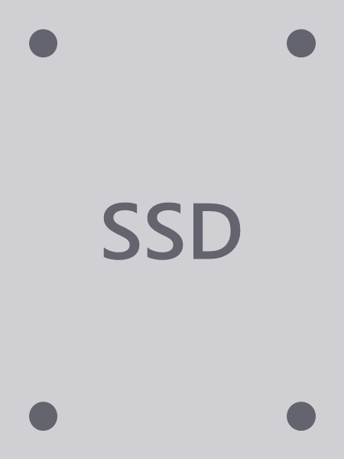
Storage Spaces
Expand capacity and increase throughput beyond individual drive limits
East US 2:
$450.56
Single Virtual Disk = 7,500 IOPS & 250 MBps​
Total Capacity = 4TiB
P50
7,500 IOPS
250 MBps
4,096 GBs
Storage Pool = 20,000 IOPS & 800 MBps​
Total Capacity = 4TiB
East US 2:
$491.52
and you get Read-Caching..
P30
5,000 IOPS
200 MBps
1,024 GBs
P30
5,000 IOPS
200 MBps
1,024 GBs
P30
5,000 IOPS
200 MBps
1,024 GBs
P30
5,000 IOPS
200 MBps
1,024 GBs
Notes:
Storage Spaces is used to increase the capacity and performance of your Azure storage. For Azure VM, Storage Spaces is not used for resiliency. It is essentially a software-based RAID 0 solution for Azure VM (with no parity).
We use Storage Spaces to group drives together into a storage pool. A storage pool is a collection of physical disks. We then use this capacity to create our virtual disks.
We don’t need Storage Spaces for resiliency as we are already getting this capability from Azure managed disks.
Now that we are putting all of this together – the Azure disk options, choosing the right VM, storage settings, caching, and employing best practices - The most important concept with all of this in mind - is that you want to use the fewest disks possible while still meeting the minimal requirements, these requirements being IOPS, throughput, and capacity.
Using the Azure Marketplace and the Storage Configuration much of this work is done for you as Storage Spaces / Storage Pools is configured behind the scenes.
In this example we can see how Storage Spaces can help us achieve a much better TCO with P30 disks versus a single P50 disk.
-----------------------------------------------
Note: On Linux, use the MDADM utility to stripe disks together. Currently, disk striping for Linux is not available through the Azure portal.
To create a storage space, you must first create one or more storage pools. A storage pool is a collection of physical disks.
From a storage pool, you can create one or more virtual disks. These virtual disks are also referred to as storage spaces. A storage space appears to the Windows operating system as a regular disk from which you can create formatted volumes. When you create a virtual disk through the File and Storage Services user interface, you can configure the resiliency type (simple, mirror, or parity), the provisioning type (thin or fixed), and the size.
Through Windows PowerShell, you can set additional parameters such as the number of columns, the interleave value, and which physical disks in the pool to use.
From a virtual disk, you can create one or more volumes. When you create a volume, you can configure the size, drive letter or folder, file system (NTFS file system or Resilient File System (ReFS)), allocation unit size, and an optional volume label.
To leverage Storage Spaces, you leverage a number of attached disks and then 1). Create one or more storage pools and next 2). Create one or more virtual disks (storage spaces) And finally, 3). Create one or more volumes.
Key Concepts
The most important concept is using the least amount of disks possible while meeting the minimal requirements for IOPS (and throughput) and capacity.
The second concept is to ensure that caching is available and enabled on your data disks only. You can look at it as an overflow store that you use only when needed.
--------------
Reference:
Deploy Storage Spaces on a stand-alone server
https://docs.microsoft.com/en-us/windows-server/storage/storage-spaces/deploy-standalone-storage-spaces

Slide 34



Azure SQL Virtual Machine storage options
1. Choose the right disk
3. Enable Write Acceleration
Premium Disk
P30s, P40s for data, P30+ for log files
M-series only
Enabled like caching in the Azure portal
Ultra Disk
Ultra Disk for low disk latencies
Beneficial for Log files
Improved disk latencies
Ephemeral Disk
Use ephemeral disk for tempdb
Disk support varies
Refer to M-series documentation
2. Enable host cache
4. Leverage Storage Configuration (Best Practices)
Data files
Read-only
Azure Portal
Enabled in the Azure portal
Log files
None
Built-in Best Practices
Blocksize, interleave, numberofcolumns
tempdb
Read-only when remote
Disk location & Features
File separation, network acceleration
Notes:
So, to sum up our disk options and the virtual machine level options we discussed in our first episode..
1. Choose the right disk
Premium SSD
Premium SSDs have low-latency disk support perfect for IO-intensive workloads. Premium SSDs can only be used with VM series that are premium storage-compatible and we only recommend VMs that support Premium Disk storage for SQL Server.
Premium disks are available from P1 up to the P80, but there are features only available on certain disk sizes.
Because of the caching support we only recommend using P30 and P40 for the Data disks. Caching support is not recommended for log files so admins can use P30 – P80 for the Log disks.
We recommend customers start with the P30 and use storage spaces to increase the throughput to the VMs limits.
Remember, the disk IOps and throughput should not exceed what that virtual machine can handle.
Ultra-disk
Ultra-disks have high throughput, high IOPS, and the lowest latency. They are perfect for data-intensive workloads and especially transaction-heavy workloads. In particular, they are useful for the transaction log when you have high log usage from SQL Server features and / or high WRITELOG waits.
Unique to Ultra-disk, you can independently configure the capacity and performance of the disk separately - in several fixed sizes, ranging from 4 GiB up to 64 TiB.
You should use Ultra Disks when you need sub-millisecond low latency writes (<1ms) especially to SQL Server log files.
Ephemeral disk
This local temporary disk is automatically created for you and is labeled as the D: drive by default. You will lose this drive on restarts / recycles when the virtual machine is deallocated, and the disk will then be recreated on startup.
The ephemeral disk is used for storing pagefile.sys and any short-term storage for applications and processes.
On Azure Linux VMs, the temporary disk is typically /dev/sdb and on Windows VMs the temporary disk is D: by default.
These disks are perfect for tempdb because of the performance of these local disks and the fact it does not count against the uncached limits of the virtual machine.
2. Enable host caching
When you enable Read-only host caching on premium storage disks, you can get better IOps, throughput, and lower read latency for your applications by taking advantage of caching made up of local SSD plus memory.
You will want to ensure that ‘read-only’ caching is used for your data files and tempdb when tempdb is not placed on the local ephemeral drive.
Do not use caching for SQL Server log files as there is no benefit.
When using read-only caching we have seen a benefit for most SQL Server workloads. Use the local cache as a performance safety net rather than having to resize to a larger VM or higher storage tier just because you see a usage spike in your workloads.
3. Enable Write Acceleration
Enabling Write Acceleration is a disk capability for M-Series Virtual Machines (VMs) exclusively. The purpose of the functionality is to improve the I/O latency of writes against Azure Premium Storage. Write Acceleration is best suited to improve log file updates for highly leveraged, transactional databases.
Restrictions when using Write Accelerator
There are limits of Azure Premium Storage VHDs per VM that can be supported by Write Accelerator.
Virtual Machine Size Disk# Write Accel Disk IOPS per VM
-------------------------------------------------------------------------------------
M416ms_v2, M416s_v2 16 20000
M208ms_v2, M208s_v2 8 10000
M128ms, M128s 16 20000
M64ms, M64ls, M64s 8 10000
M32ms, M32ls, M32ts, M32s 4 5000
M16ms, M16s 2 2500
M8ms, M8s 1 1250
4. Leverage Storage Configuration (Best Practices)
If you remember anything, know that when you use the Azure marketplace images and the storage configuration template many of the storage best practices, we recommend are employed for you. The blocksize will be set to 64 kb, the interleave will be set to 64 kb, and the number of columns will match the number of disks.
Data files will have read-caching enabled and will be placed in a separate location from the SQL Server log files. The tempdb system database will be placed by default on the local ephemeral disk.
Network acceleration will be enabled by default.
This template is very easy to use and is available from the SQL Server tab on any Azure Marketplace image.
-------------------------------------------
Terms
Block Size and Interleave
The block size is a measurement of the I/Os in KBs that the storage sub-system handles. Microsoft SQL Server uses smaller block sizes (8KB – 32KB).
In general, IOPs and throughput are inversely related to block size. A small block size yields high IOPs with low throughput, while a large block size results in high throughput with low IOPS.
One of the parameters in Storage Spaces that can be adjusted is interleave which is basically how large this stripe is supposed to be on each disk. If the size 256 KB (default) is used, this would mean that Storage Spaces stores 256 KB of data on each column (or disk) that was assigned to the storage space.
The number of columns specifies how many physical disks data is striped across and has an impact on performance regardless of stripe and block size. In Azure we are going to recommend architecting for performance and setting the numberofcolumns eq to the # of disks. Azure storage configuration will scale the the column with the disk up to eight, but you can adjust this parameter by using Windows PowerShell if you have more than 8 disks.

Slide 35
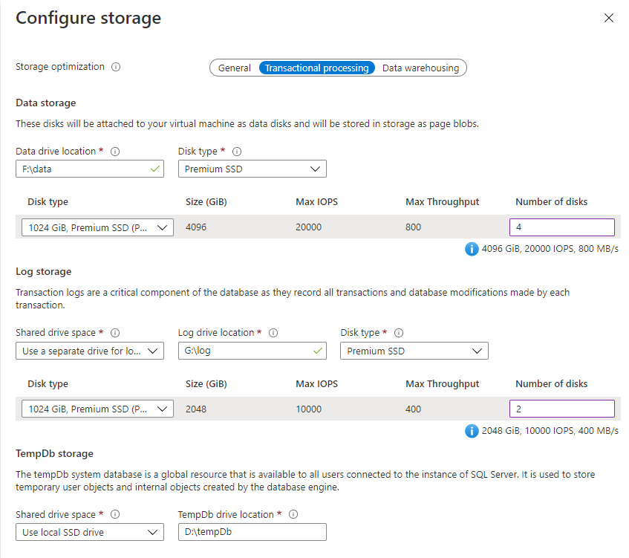

Slide 36
Avoid Common Storage Workload Pitfalls
Collecting a performance baseline
Storage Configuration Optimization
Burstable* Disks and Virtual Machines
Previous and older generation sizes
Missing SQL Server I/O Best Practices
Leading with CPU and Memory
Notes:
1. Leading with CPU and Memory - Just make sure you are leading with storage (IOPs/throughput) for sizing as it is much more difficult to rebuild storage than to resize a VM. Plus, this is what we find to be the biggest bottleneck in most environments.
2. Missing the Performance Baseline Step – Ideally, you should choose the storage solution based on performance history. The source IOPS and throughput is the key to getting the storage right. It is recommended to collect peak IOPS and throughput for Data, Log and tempdb and choose the VM size that can scale to the total* IOPS requirement. Once you get the storage solution you should match memory and core requirements based on performance history. Remember, it is much easier to change and scale your compute than to rebuild storage. Get the storage right up front!
2. Storage Configuration Optimization - Storage configuration misses are the most impactful. First, All SSDs are not the same. Standard SSDs are significantly slower than premium. You need premium disks, and you need to make sure you have the block size and the interleave set to 64KB if you are using storage pools. You should also have the NumberofColumns set to the number of disks allocated. Finally, Make sure you pick VMs that supports Premium Storage Caching and make sure you enable caching for SQL Server Data Files (read-only) and set to ‘none’ for transaction log files. You can avoid issues by making sure you leverage the Azure Marketplace storage configuration wizard.
4. Burstable* Disks and Virtual Machines – The burstable technology is something you will want to revisit as this space is evolving, check the links we have provided – note that we have both a credit-based system and a paid for ‘on-demand’ system. Burstable disks and virtual machines, such as the B-series VMs, are okay for workloads that do not need the constant, full performance of the CPU like web servers, proof of concepts, and development environments – but we do not recommend them for enterprise SQL environments.
The B-series provides you with the ability to purchase a standard VM size that can build up credits when it is using less than its baseline.
When the VM has accumulated credits, the VM can burst above the baseline using up to 100% of the vCPU when your application requires higher CPU performance.
This might work well for smaller web servers and some small to mid-tier business intelligence systems, but this is generally not what you would want for a production SQL Server environment.
5. Previous and older generation sizes - It is generally recommended to use the latest VM series and the ones we mentioned previously. The previous generation virtual machines are on older hardware and are less likely to support features such as Premium Storage and Premium Storage caching. You may have noticed that the newest M-Series mid tier memory virtual machines were Gen 2 only.
6. Missing SQL Server IO Best Practices – Use the latest compatibility level for your databases, Enable lock pages in memory, set the max server memory for SQL Server, Enable instant file initialization, leverage QDS, and use features such as ColumnStore indexing and data compression in a targeted manner. You are still a DBA and even more so in the cloud. ABT!

Slide 37
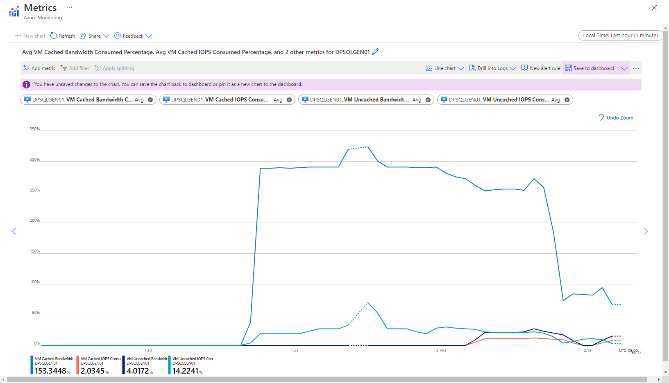
Notes:
1. With a bullet, storage configuration misses are the most impactful. First, All SSDs are not the same. Standard SSDs are significantly slower than premium. You need premium disks, and you need to make sure you have the block size set to 64KB and the interleave set to 64KB if you are using storage pools. You should also have the NumberofColumns set to the number of disks allocated.
2. Make sure you pick VMs that supports Premium Storage Caching and make sure you enable caching for SQL Server Data Files (read-only) and none for transaction log files. You can avoid issues by making sure you leverage the Azure Marketplace storage configuration wizard.
3. Azure Spot VMs are great if you are looking to save money, but at any point in time when Azure needs the capacity back, the Azure infrastructure will evict Spot VMs.
Spot VMs are great for workloads that can handle interruptions like batch processing, dev/test environments, large compute workloads, and other scenarios where disruptions are acceptable.
If disruptions are not acceptable – do not enable this feature!
4. Burstable disks and virtual machines, such as the B-series VMs, are okay for workloads that do not need the constant, full performance of the CPU like web servers, proof of concepts, and development environments.
The B-series provides you with the ability to purchase a standard VM size that can build up credits when it is using less than its baseline.
When the VM has accumulated credits, the VM can burst above the baseline using up to 100% of the vCPU when your application requires higher CPU performance.
This might work well for smaller web servers and some small to mid-tier business intelligence systems, but this is generally not what you would want for a production SQL Server environment.
4. It is generally recommended to use the latest VM series and the ones we mentioned previously. The previous generation virtual machines are on older hardware and are less likely to support features such as Premium Storage and Premium Storage caching. You may have noticed that the newest M-Series mid tier memory virtual machines were Gen 2 only.
5. ‘Starting with a pre-set configuration’ is an Azure portal option that does too much for you for a production environment. Yes, it is quick and straightforward, but you want to be able to go through the options and validate or make adjustments before you deploy while using the Azure SQL Server IaaS Agent Extension experience.

Slide 38
Adding I/O capping metrics to your dashboard

Slide 39






Azure SQL VM Storage Best Practices
Temp Drive
Host Cache
Data
Temp
Log
Obtain perfmon source metrics
Choose the right disk
Isolate files
Enable host cache
mapped to IOPS, BW and latency
to optimize read vs write traffic
for improved IOPS and latency
to optimize target storage
D:/
Temp
SQL I/O Best Practices
Leverage ephemeral disk
Configure Storage Wizard
Leverage Azure Monitor
Apply Best Practices to preserve throughput
local ephemeral disk for tempdb performance
Leverage the Azure Portal to employ storage
Best Practices
watch disk and vm counters for capping
Notes:
References:
Recommended Articles:
Pricing - Managed Disks | Microsoft Azure - https://azure.microsoft.com/en-us/pricing/details/managed-disks/
Select a disk type for Azure IaaS VMs - managed disks - Azure Virtual Machines | Microsoft Docs - https://docs.microsoft.com/en-us/azure/virtual-machines/disks-types
Managed disk bursting - Azure Virtual Machines | Microsoft Docs - https://docs.microsoft.com/en-us/azure/virtual-machines/disk-bursting
Azure premium storage: design for high performance - https://docs.microsoft.com/en-us/azure/virtual-machines/premium-storage-performance
Disk metrics - Azure Virtual Machines | Microsoft Docs - https://docs.microsoft.com/en-us/azure/virtual-machines/disks-metrics
Configure storage for SQL Server VMs - https://docs.microsoft.com/en-us/azure/azure-sql/virtual-machines/windows/storage-configuration
Checklists and Best Practices:
Checklist: Performance best practices for SQL Server on Azure VMs https://aka.ms/SQLVMChecklist
VM size: Performance best practices for SQL Server on Azure VMs https://aka.ms/SQLVMSizing
Storage: Performance best practices for SQL Server on Azure VMs https://aka.ms/SQLVMStorage
How to get the biggest bang for your buck with SQL Server on Azure VMs https://aka.ms/AzureSQLVMPricePerf
Deep Dive: Azure SQL Virtual Machine Sizing | Data Exposed Live (YouTube) https://aka.ms/SQLVMSizingVideo

Slide 40
Questions?

Slide 41
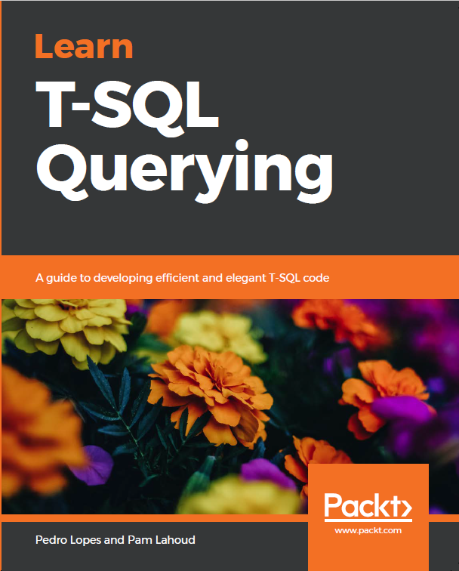
Learn more
Check out these great data-related demos
https://aka.ms/DataDemos
https://aka.ms/IQPDemos
Continue learning with our new book
https://aka.ms/LearnTSQLQuerying
One shortcut to rule them all!
https://aka.ms/SQLShortcuts
Download and try SQL Server 2019
https://aka.ms/ss19
https://aka.ms/LearnTSQLQuerying_errata
https://aka.ms/SQL2019Notebooks
Use our free training
https://aka.ms/sqlworkshops
https://aka.ms/SQL2019WhatsNew

Slide 42


